Slide 1
Pure and Impure Substances

Slide 2

By the end of this lesson you should be able to:
1. | Describe what an example of a pure substance is.
2. | Describe what an example of an impure substance is.

Slide 3
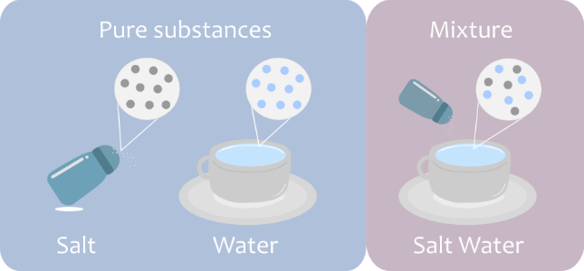
Everything is made up of particles.
A pure substance is made up of only one type of particle.
An impure substance is made up of many different types of particles. An impure substance is also called a mixture.

Slide 4
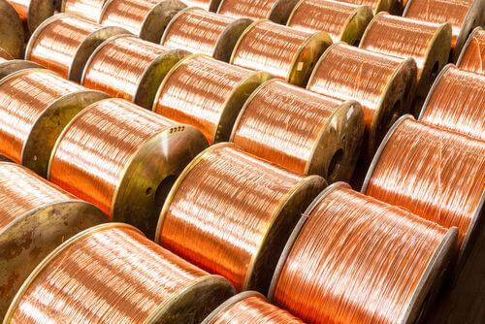
A pure substance contains particles of one kind.
For example, copper metal contains only copper particles.
Another pure substance is oxygen gas. This contains only oxygen particles.

Slide 5
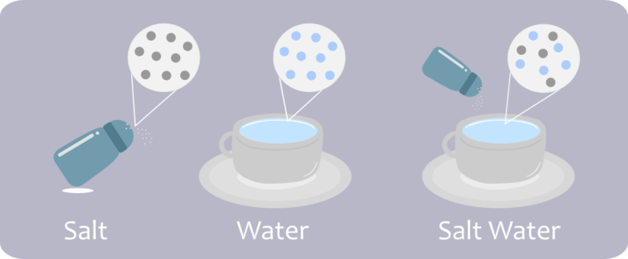
The diagram below shows salt and water magnified to see their particles.
Salt only has grey particles, and water only has blue particles.
When we combine them, we see the blue and grey particles are mixed together. This is why it is called a mixture.

